Slide 1
Privacy on social network sites
Manya Sleeper
11/20/13

Slide 2
Privacy is a concern for social networks
Widespread use
Large, varied audiences
Misperceptions of audience size
Misperceptions/misuse of privacy tools
Privacy attitudes don’t always match behaviors
Potential for minor to severe consequences

Slide 3
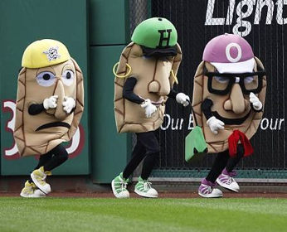
In the news…
16-year old fired for saying “I’m so totally bored” on Facebook at her job
“Pittsburgh pierogi mascot fired for bashing team on Facebook”
Woman lost sick leave benefits for depression because she looked too happy in photo on Facebook
Rosen, J. 2010. “The Web Means the End of Forgetting” The New York Times
Boyle, C. 2010. “Pittsburgh pierogi mascot fired for bashing team on Facebook.” NYDailyNews.com
Kantor and Kantor LLP. 2009. “Facebook Pictures Lead to Diisability Beefits Denial”

Slide 4
Privacy attitudes and behaviors
Acquisti and Gross. 2006. “Imagined communities: awareness, information sharing, and privacy on the facebook”
Used survey and network data to look at privacy attitudes and behaviors
One school Facebook network
Used questions about attitude toward varied issues to measured concern about privacy (e.g., economics, politics, privacy)
Non-Facebook users significantly more likely to be concerned about privacy but not other issues (not true for undergrads)
Acquisti, A. and R. Gross. 2006. Imagined communities: awareness, information sharing, and privacy on the facebook. PET.

Slide 5
Privacy attitudes and behaviors
Birthdays but not phone numbers on Facebook
Females less likely to share sexual orientation but just as likely to share “birthday, schedule of classes, partner’s name, AIM, or political view”
“Little or no relation between” privacy attitudes and information shared
Acquisti, A. and R. Gross. 2006. Imagined communities: awareness, information sharing, and privacy on the facebook. PET.

Slide 6
Privacy attitudes and behaviors
22% of respondents didn’t know “what the FB privacy settings [were]”
24% thought anyone could find their profiles
16% thought “anybody on FB [could] read their profiles]”
77% hadn’t read Facebook’s privacy policy (but, on average, tended to trust Facebook)
Acquisti, A. and R. Gross. 2006. Imagined communities: awareness, information sharing, and privacy on the facebook. PET.

Slide 7
Evolving privacy attitudes and behaviors
Stutzman et al. 2012. “Silent Listeners: The Evolution of Privacy and Disclosure on Facebook”
Facebook has changed since initial paper (and so has society’s reaction to social networks)
6-year longitudinal study of privacy and sharing behaviors on Facebook at CMU
Stutzman, F., A. Acquisti, and R. Gross. 2012. Silent listeners: The evolution of privacy and disclosure on Facebook. J of Privacy and Confidentiality.

Slide 8
Evolving privacy attitudes and behaviors
Participants shared less data with the general public in general
But shared more data, in general, with their friends and at the same time with “third-party apps, (indirectly) advertisers, and Facebook”
Changes in the Facebook interface/defaults led to an increase in public sharing of some types of personal data
Stutzman, F., A. Acquisti, and R. Gross. 2012. Silent listeners: The evolution of privacy and disclosure on Facebook. J of Privacy and Confidentiality.

Slide 9
Impression/Audience management
Context collapse (Marwick and boyd):
Social networks (e.g., Twitter) flatten “multiple audiences into one” which “makes it impossible to differ self-presentation strategies”
Group co-presence (Lampinen):
Multiple groups (e.g., friends, work, etc.) are present on a social network
Identity and privacy need to be maintained through technical and informal mechanisms
Marwick, Alice E and danah boyd. I tweet honestly, I tweet passionately: Twitter users, context collapse, and the imagined audience. New Media & Society. 2011.
Lampinen, Airi, Sakari Tamminen, and Antti Oulasvirta. "All my people right here, right now: management of group co-presence on a social networking site." Proceedings of the ACM 2009 international conference on Supporting group work. ACM, 2009.

Slide 10


“I read my Twitter the next morning and was astonished” A Conversational Perspective on Twitter Regrets
Manya Sleeper, Justin Cranshaw, Patrick Gage Kelley, Blase Ur, Alessandro Acquisti, Lorrie Faith Cranor, and Norman Sadeh

Slide 11
It’s easy to say something you regret.
If you turned up dead, no one would miss you!
I hate you!
You look like you’ve gained a lot of weight…

Slide 12
Past research analyzed in-person regret:
Factors leading to regret
Types of regret
Awareness of regret
Strategies to repair regret

Slide 13
It’s also possible to tweet something you regret
Thanks for putting me at risk of getting fired
Maybe, if you would take your stupid elsewhere…I wouldn’t have to be so blunt
Man, I hate you, you are the worst person ever, should’ve never been born

Slide 14

Twitter is different

Slide 15

Twitter allows for:
Wider audiences
Lack of face-to-face channel
Increased persistence

Slide 16
To understand how Twitter regrets compared to conversational regrets…
…looked at Twitter users’ regretted messages from in-person conversations and on Twitter.

Slide 17
Regretted messages on Twitter and in person
What states lead to regret?
What types of regret occurred?
How did people become aware of regretted messages?
What repair strategies did people use to cope with regretted messages?

Slide 18

Large-scale online survey
Amazon Mechanical Turk
1,221 Twitter users
English proficiency
Relatively frequent Twitter use
Reported a regret
Photo © Victor155 used under a Creative Commons License: http://creativecommons.org/licenses/by/3.0/License

Slide 19
Survey with two conditions
Conversational and Twitter conditions
Asked to “recall an occasion when” said or tweeted something and then regretted it
Described:
Regret
Circumstances leading to regret
How became aware of regret
Repair strategies

Slide 20
Data coding and analysis
Coded open response questions based on in-person conversational regrets literature
Did not perform statistical comparisons across conditions
Different contexts (Twitter/conversation)
Qualitative explored themes/trends
Performed statistical tests within conditions

Slide 21
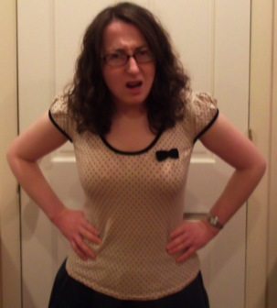
States leading to regret
Negative emotional states common
Stress
Anger
Frustration
Positive emotions less common

Slide 22
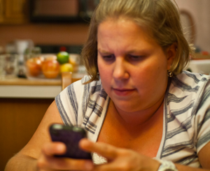
Types of regrets
Codes from conversational regrets literature (Knapp et al.)
Most common:
Direct criticism
Direct attack
Implied criticism
Expressive
Revealed too much
Blunder

Slide 23
Both conversational and Twitter participants most often regretted being critical of others
“I told my cousin I hate her and never wanted to see her again”
“I wrote that my brother was making a mistake by getting married to Juanita”
“I accidentally implied i only liked my girlfriend for the sex”

Slide 24
Twitter blunders included typos and broken links
“…we ended up tweeting a bad link a couple times. It made us look unprofessional...”
“i used alot of hags on my car”
“…I sent out a tweet mispelling the name of an important speaker for an upcoming company event”

Slide 25
14% of Twitter participants reported regretting expressive content
“I was mad so I tweeted ‘I hate every single person on twitter.’”
“I tweeted about how I was intoxicated and depressed”
“I tweeted about how much I hated working at my job, then regretted it instantly, thinking that a co-worker or supervisor would see it.”

Slide 26
Types and audience
Asked participants for intended audience
Twitter participants tended to target multiple people (73% reported)
Types significantly more likely to be targeted at multiple people:
Blunders (82%)
Expressive content (84%)
Content that revealed too much (80%)

Slide 27
Awareness: Conversation
“When he gave me an angry look and yelled at me”
“When she began to cry I realized how much I hurt her…”

Slide 28
Awareness: Twitter
“As soon as I got a text from the girl I had vented on twitter about. She was none to happy.”
“my heart told me"
“I just felt guilty"
“Re-reading it the next morning kind of gave me a feeling in my stomach like, ‘wow, I probably shouldn't have sent this.’”
“Once some of my old classmates and friends DM me and told me to stop and that it was very immature of us.”

Slide 29
Repair strategies
Twitter
Conversational

Slide 30
Time to awareness and repair
Most conversational awareness immediate (63%), repaired within few minutes (52%)
Twitter participants reported awareness and repair that lagged

Slide 31
Time to awareness and repair

Slide 32
Limitations
Limited to U.S. MTurk workers
Participants recalled single regretted message
Used self-reported, recalled data

Slide 33
Potential regret mitigation
Detect and prevent regret through interface…
Feedback about negative emotions
Visualize audiences
Promote regret awareness
Visualize potential reactions
Help communities provide feedback

Slide 34
Conclusions
Twitter participants tended to regret critical messages, often targeted at broad audiences
Twitter participants often became aware of regret hours or days later
Twitter participants often relied on self-awareness or third-parties to tell them about regrets, absent physical audience cues
Once aware of regrets, Twitter participants tended to delete the regretted tweet and/or apologize

Slide 35
Ad hoc strategies for privacy on social networks
Multiple accounts (Lampinen)
Deletion/deactivation (boyd)
Self-censorship (boyd, Lampinen)
Others?

Slide 36
The Post that Wasn’t: Exploring Self-Censorship on Facebook
Manya Sleeper, Rebecca Balebako, Sauvik Das, Amber Lynn McConahy, Jason Wiese, Lorrie Faith Cranor

Slide 37
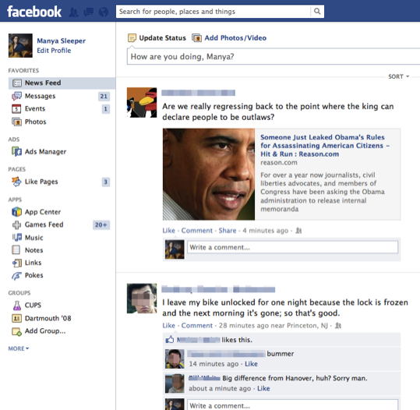
When we look at Facebook we can see what people have posted.

Slide 38
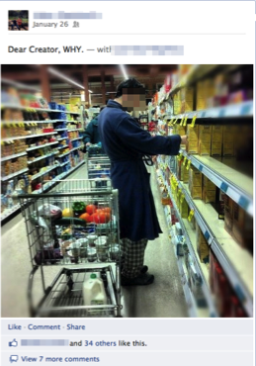
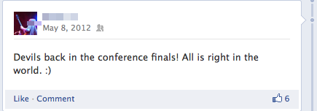
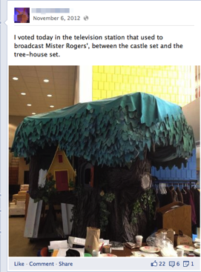
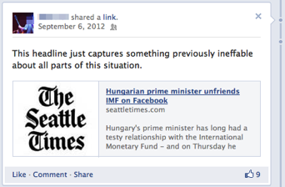

Slide 39

We don’t see what people don’t post.
Photo © Victor15 used under a Creative Commons License: http://creativecommons.org/licenses/by/3.0/License

Slide 40
Self-censorship is interesting

Slide 41
1. What are users not sharing?
2. Why do they choose not to share different types of content?

Slide 42
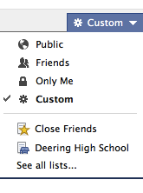
I hate my sister so much! Oh wait…no I don’t.
Sometimes self-censorship can be good
…but sometimes it occurs because of interface limitations

Slide 43
3. What subset of currently unshared content could potentially be shared if users could exactly target their intended audiences (optimal selective sharing)
4. What attributes typify the groups with whom users would want to share this content?

Slide 44
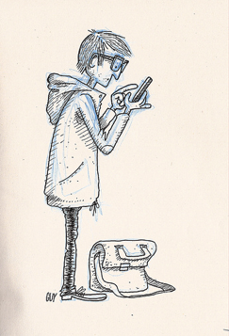
Methodology
7-day diary study
SMS messages
Whenever thought “of things that they would like to post on Facebook but decide[d] not to post.”
Photo © Guillaume Perreault used under a Creative Commons License: http://creativecommons.org/licenses/by/3.0/License

Slide 45
Methodology
Details in nightly surveys
Contained SMS items
Asked for additional details, shared content
Hour-long semi-structured final interview

Slide 46
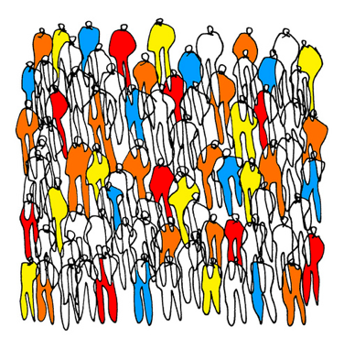
Participants
18 participants
Screened for English, Facebook use, SMS use, and holding back content
10 female, 8 male
Photo © Fernando Leiva used under a Creative Commons License: http://creativecommons.org/licenses/by/3.0/License

Slide 47
Data coding
Coded for:
Types of content
Reasons for not sharing
Types of people would have wanted to share with/block (where relevant)
Used data from nightly surveys and interview
Iteratively coded all items

Slide 48
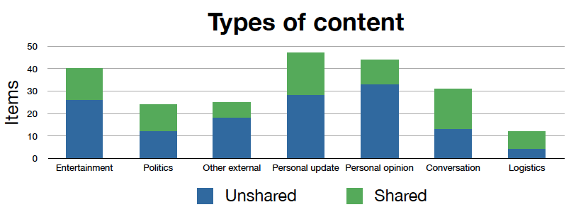
Types of content
Drug-related video that a participant decided not to share because her “family in Austin is really religious”

Slide 49
Types of content
Decided not to post a “Link to article about young black republicans” to avoid controversy
Wanted to post links to “articles I read on NPR and WeArePowerShift.org – very political stuff” but “I like to keep politics off my Facebook page”

Slide 50
Types of content
“My brother-in-law wants to get a tattoo and I was going to comment on how stupid it was; but I decided not to”
“Kicking ass and taking names!!! Happy Monday!!!”

Slide 51
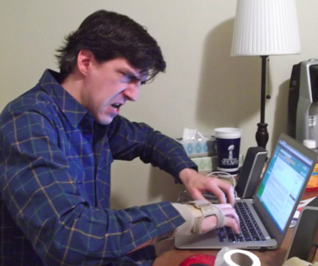
Reasons for not sharing
Presentation of self
Potentially offensive
Boring/repetitive
Avoid argument/discussion
Inconvenient
Notes:
Coded each item for one or more reason not to share. Largest category was presentation of self issues – 34% of items. Items participants didn’t post because it “seemed silly” or “don’t like to post that kind of thing” Remaining categories each about 20% of content. Argument or discussion – didn’t want to start an argument or discussion. Offend – didn’t want to offend or hurt someone. Boring /repetitive – felt the content was redundant or boring. – Inconvenient – prevented due to time or technology, for example was on a pool deck and didn’t have easy access to a computer.

Slide 52
Potential for selective sharing
Optimal selective sharing: how much would have shared if could have only targeted particular audiences
On five-point scale, how likely or unlikely to share if:
Could have shared item only with people they wanted to share it with
Could have prevented people they didn’t want to see item from viewing it

Slide 53
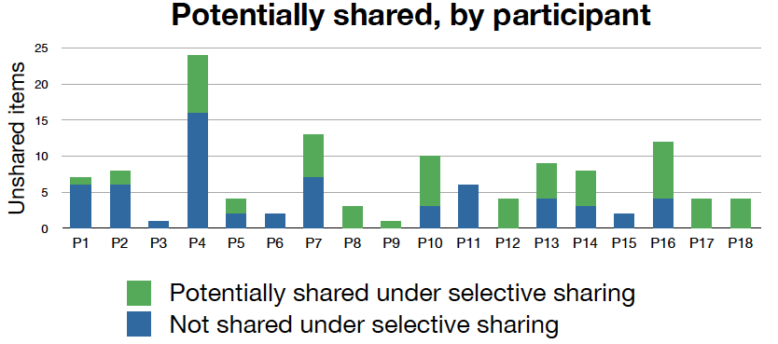
Potential for selective sharing
Approximately half of unshared content would potentially be shared under optimal selective sharing

Slide 54
Types of groups for selective sharing
To allow for selective sharing would need interface grouping mechanisms
Asked participants to specify who wanted to share with or block

Slide 55
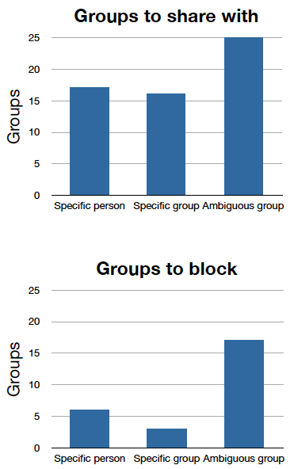
Types of groups
Specific people: e.g., “my sister”
Specific groups: countable set of people (e.g., 10 close friends)
Ambiguous groups: defined by one or more attributes or relationships (e.g., “hockey friends”)

Slide 56
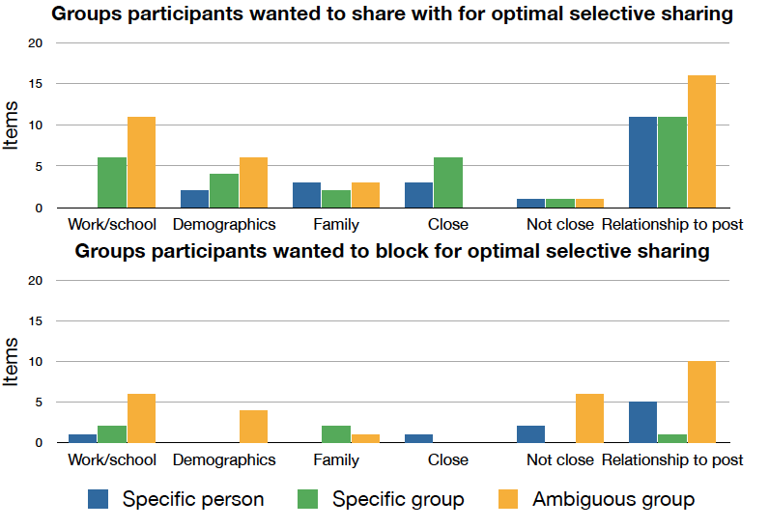
Group attributes

Slide 57
Groups needed for optimal selective sharing
Some groups could be captured by Facebook interface
Need to capture more ambiguous groups
Context-specific information
Traits potentially unknown to the user

Slide 58
Limitations
Qualitative diary study with small sample
Skewed young
Self-reported data
Subset of self-censored content

Slide 59
Conclusions
External content most commonly self-censored followed by personal content
Presentation of self most common reason
Half potentially shared under optimal selective sharing
Some specific individuals and groups potentially could be captured by current interface
Also wanted to target more ambiguous groups that would require new tools

Slide 60
Discussion
Maintaining presentation of self on an online social network is often important to users – what are the official/unofficial mechanisms available to do so for: Twitter, FB, etc?
What are the benefits/downsides of each?
Why are each chosen?

